Slide 1
Developing a Preaching Calendar
Dr. Doug Oss, Ph.D.

Slide 2
Developing a Preaching Calendar
“Preachers can easily fall into ruts in preaching, and before they realize it, they are preaching one type of sermon most of the time, or are favorite doctrine to the exclusion of others…No aspect of sermonic preparation offers greater opportunity for variety than this part of the preaching task.”
Faris D. Whitesell and Lloyd M. Perry. Variety in Your Preaching. Westwood, NJ: Fleming H. Revell Company, 1954, p. 181.

Slide 3
A Master Preaching Calendar Offers Many Advantages

Slide 4


1. It allows you to see the complete picture of the pulpit better.
- Where does God want us to go?
- Why does He want us there?
- How will we get there?

Slide 5
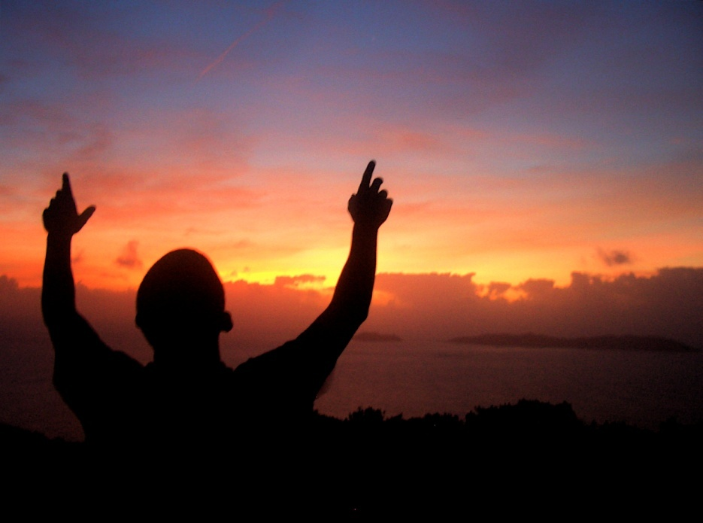
2
It permits you to integrate your work in the pulpit with teaching which is done elsewhere in the church.

Slide 6

3
It protects you from preaching too many times on the same subject.

Slide 7

4. It saves time.
Many hours can be wasted searching for a text and support material instead of working on a specific message.

Slide 8

5
It gives peace of mind from clear direction.
A track has been laid so that you know where you will be preaching. At this point you may not have determined all the Homiletical issues, but the certainty of where you will be helps bring poise as you approach the task of weekly preparation.

Slide 9
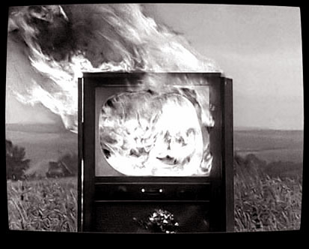
6. It off-sets interruptions.
If you know exactly where you are going four or five weeks from now, you can tolerate the interruptions easier.

Slide 10


7. It drives the preacher to his study.

Slide 11

- 8 -
- 8 -
It encourages a balanced ministry from the pulpit by planning when outside speakers, films, or groups will be ministering to the people.
If someone requests time to address the people, a planned pulpit ministry either allows for it or gives some rationale why the guest cannot be included.

Slide 12

9. It facilitates variety in the scope of the message.
If you design a year of preaching you are more likely to include topical studies as well as book studies. You should also able able to see at a glance where your longer or shorter series will fall.

Slide 13

10. It becomes easier to schedule messages on the basis of goals or objectives.
If you know unsaved people will be present at a baptismal service, then your objective of evangelism may help to dictate what is preached.

Slide 14




11. It allows other ministers in the church to coordinate their work with yours.
Educational and music ministries can accent your messages of special interest to them.

Slide 15

12
It enables you to advertise special series well ahead of time so that your own people as well as visitors can plan to attend messages of special interest to them.

Slide 16
Follow these guidelines as you plan a preaching calendar.

Slide 17

1. Allow enough time to preach adequately through a series.
The book of Romans will require more than one quarter (13 weeks). Be ready to break a longer Book study by shorter series (Beatitudes, Disciples, Resurrections to break up Matthew series.

Slide 18

2. Be careful about staying in one book too long.
Sometimes we assume that everyone is as interested in methodical analysis as we are . Remember that you are preaching.

Slide 19



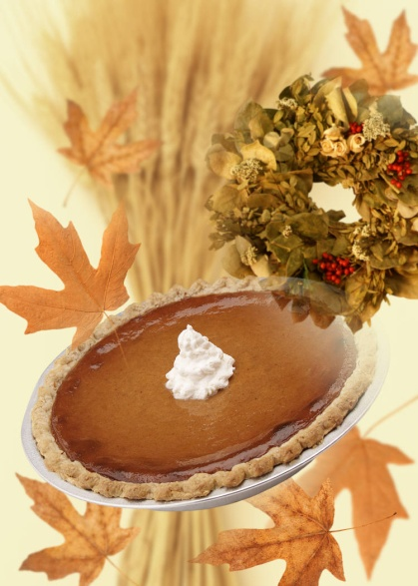


3. Do not hesitate to interrupt a series for a timely message.
Consider Valentine’s Day, Independence Day, Labor Day, etc. along with Advent-Christmas, Lent-Easter, etc. You also might consider a series on the family between Mother’s Day and Father’s Day.

Slide 20
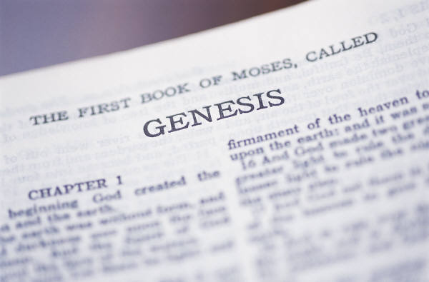
4. Set up a long-range program for preaching through the major books of the Bible.
This helps acquaint your people with the content of the books and ground them in biblical theology. You will also put the emphasis where God puts the emphasis.

Slide 21

5. Balance Old Testament studies with New Testament messages so the people have a good view of the Bible as a whole.

Slide 22
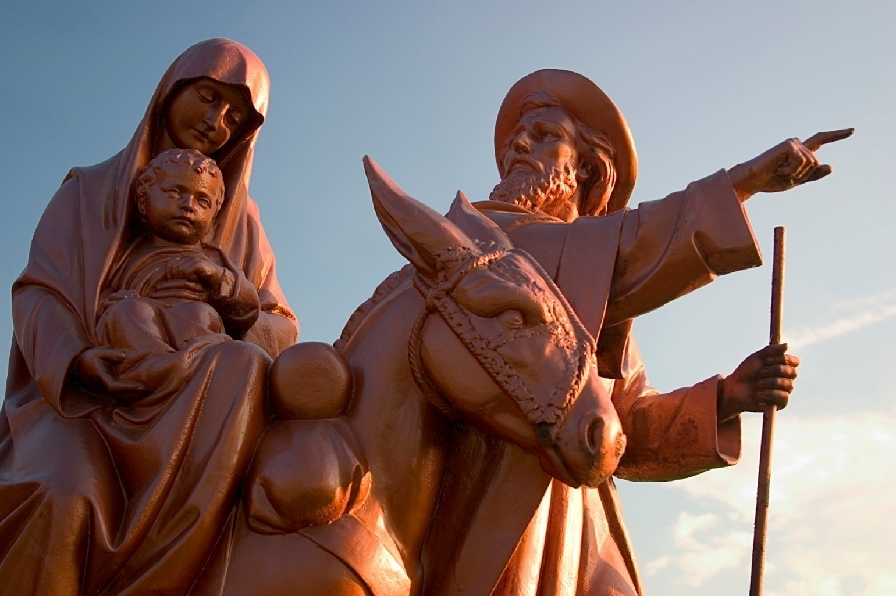
6. Seasonal series can be helpful periodically.
For example, preaching on prophecies of Christ from Christmas to Easter, or hosting Fall Evangelism, Winter Bible, Spring missions, or Summer home series.

Slide 23

7. Survey your congregation to determine their needs.

Slide 24



8. Solicit suggestions from your leaders in the congregation.
You will need to open the door for their suggestions or they will not likely provide them. Your official board can be extremely helpful by giving you a different perspective.

Slide 25
9. Creatively establish your annual master pulpit plan.
What does God expect of your pastor?
What does God expect of His people?
What does God expect of pastor and people working together?

Slide 26

10. It is wise to address the trends of the times.
What does the Bible say about immorality among leaders? How should today’s believer respond to the AIDs epidemic? How active should a believer be in the political arena?

Slide 27
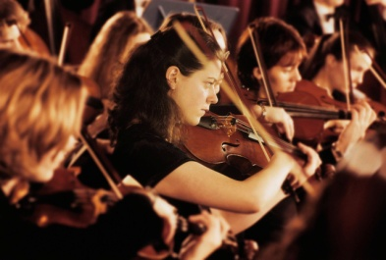


11. Use variety within the bounds of propriety.
Do not restrict the people to constant listening to you. You will need to determine how much of the public pulpit work should be done by you.
You will also want to plan time away for a true vacation as well as study leave.
Films, panels, question & answer, drama, cantatas, children’s church, youth in charge, missionaries, bible conference, family conference, etc.

Slide 28

12. Review the previous years’ calendar(s) before establishing the new pulpit plan.
This protects continuity in the pulpit. It also can be a time of evaluation of performance in light of goals.

Slide 29

13. When it is warranted, do not hesitate to break away from the calendar to preach a message which has not been scheduled in the yearly plan.

Slide 30

14. Tie your calendar planning into your Long-term Sermon Development’s “Creative Ideation” time.
Plan a time to “get away”. Set clear goals for the time away. Include time for spiritual fitness. Include time for physical fitness.

Slide 31
15
When you plan the calendar, as well as when you depart from the calendar, make prayer and integral part of your life. There is no substitute for knowing the Author of the Book and the Head of the Church.

Slide 32
Developing a Preaching Calendar
Dr. Doug Oss, Ph.D

